Slide 1
Nordiana Bt Abdull Rahman Ahmad Nadzrin Bin Ibrahim Nur Hidayah Bt Samsudin Aina Fareena bt Mohd Fadzil
ADAMHAWA.COM

Slide 2
Introduction
AdamHawa.com is a online dating website for those out there who are still looking for a life partner to equip themselves in building a family of sakinah.
Apart from that, AdamHawa.com is also a online dating website dating to the Malay Muslim community in Malaysia.
AdamHawa.com claim to be a world destination for casual dating, and are full of features that give you a lot of choices, from the way you discover others, the way you plan your profile.

Slide 3
Services
This service includes searching for couples that match the criteria you want and this service is open to Muslims Malaysian citizens aged 18 and above, either single, widowed and serious in finding a mate.
AdamHawa.com also always finds the right partner for you and your personal data like your real name and phone number are hidden before you know your partner.
Your personal profile is specific to registered and paid users only at AdamHawa.com. Registered but non-paid users cannot see in your personal profile details.
.

Slide 4
Basic
Free
Cannot see the personal data
Premium
(Lifetime)
RM100 for lifetime subscribed
Can find their partner easily without limitation
Premium
(6 Months)
Rm40, subcribed only 6 months
Only can access the account they want but limited to 10 person only
Can get their favourite partners personal data
Only can access the list of partners without their personal information.

Slide 5
Swim Lane of AdamHawa.com

Slide 6
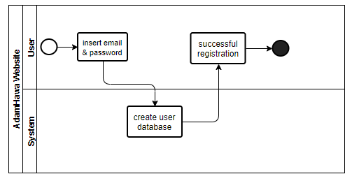

Slide 7
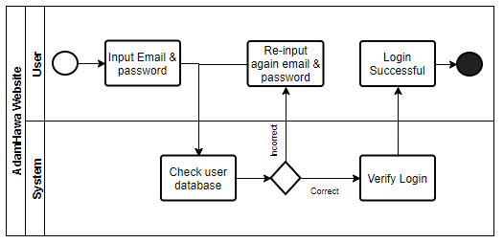

Slide 8
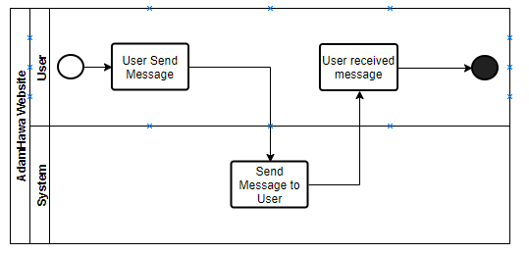

Slide 9
Work Breakdown Structure (WBS)

Slide 10
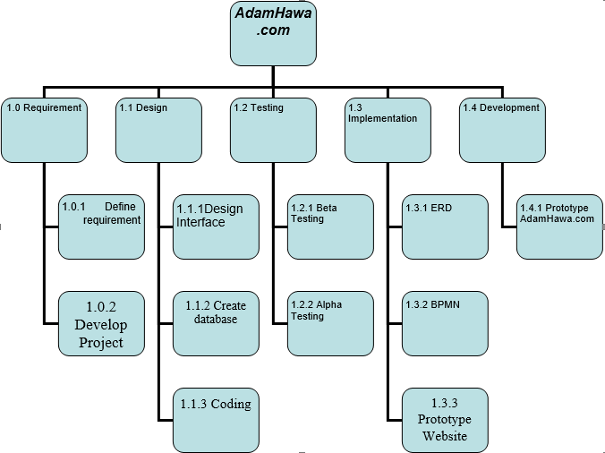

Slide 11
Entity Relationship Diagram (ERD)

Slide 12
